Slide 1
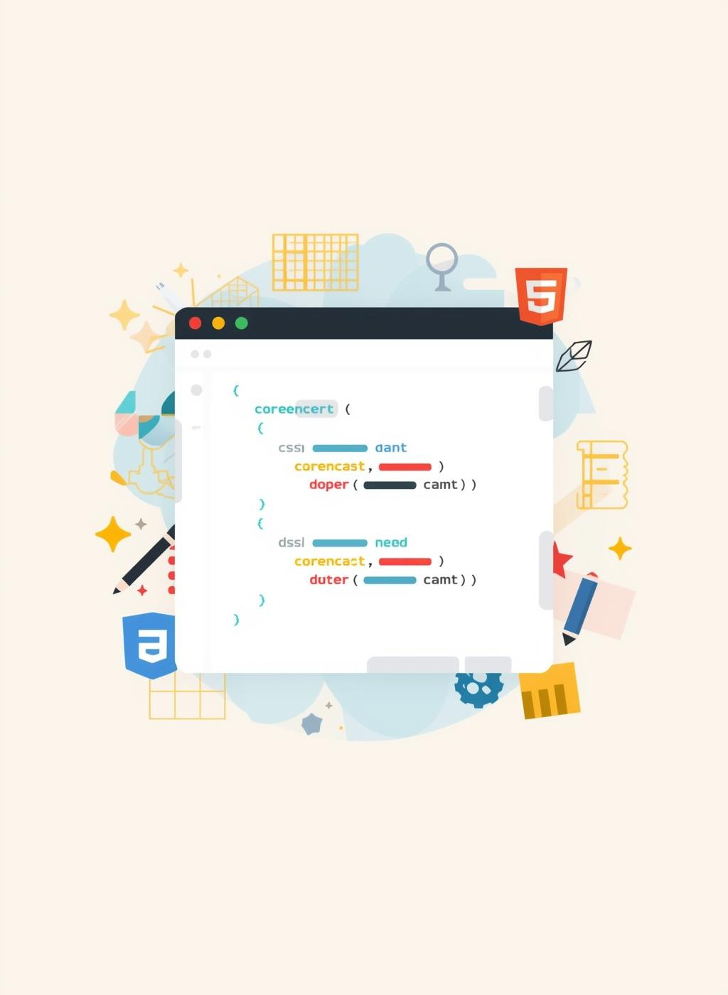
CSS Introduction & Styling Basics

Slide 2
Objectives
  The definition of CSS
  CSS selectors
  CSS Property
  Using different ways to style the page
  Pseudo classes

Slide 3
What is CSS?
Cascading Style Sheets
CSS controls the look and feel of web pages, separating content from presentation for better design flexibility.

Slide 4
CSS Selectors Overview

Slide 5
Common CSS Selectors
  Tag Selector: select an element by the tag name
  Class Selector: select a class by its name, add a dot before the class name
  ID Selector: select an ID by its name, add a `#` sign before the ID name

Slide 6
CSS Properties
  Color
  Font-size
  Font-weight
  Background-color
  Opacity
  Margin
  Border
  Padding
  CSS Text
  CSS Height and Width

Slide 7
Pseudo classes
  hover: change the cursor for the mouse to be a pointer to indicate that the element is clickable
  active :When clicking an any element it changes it's state to active and it stays active as long as the user keeps holding the click, it is mainly used with anchor tags.
  disabled : used to change the style for elements that are disabled
  visited: used to change the style for links that are opend

Slide 8
Ways to Apply CSS

Slide 9
CSS Application Methods
CSS can be applied through inline, internal, or external stylesheets, each offering unique benefits for web development.

Slide 10
Task: Using your personal / business website HTML page, style it with CSS . Focus on:
1️⃣ Headings & Paragraphs
• Change text colors
• Change font family and font size
2️⃣ Links
• Add hover effect (:hover) to links
• Change link color
3️⃣ Images
• Add border or padding
• Adjust image size with width or height
4️⃣ Background
• Add a background color to the page or sections
• Optionally, add background color to menu categories
5️⃣ Box Model
• Add margin and padding to sections or elements
• Experiment with borders for menu items
Note: Use external CSS file (style.css)

Slide 11
Thank you!

